Slide 1
BANK CHURN DATA ANALYSIS
1
ML-1 MINI PROJECT (Classification)
Presented by NICHITA PAL
Mentored by KOMILLA BHATIA

Slide 2
2
Current Scenario
Customers are exiting the bank.
Objective
Identifying the customers with a higher probability of leaving the bank.

Slide 3
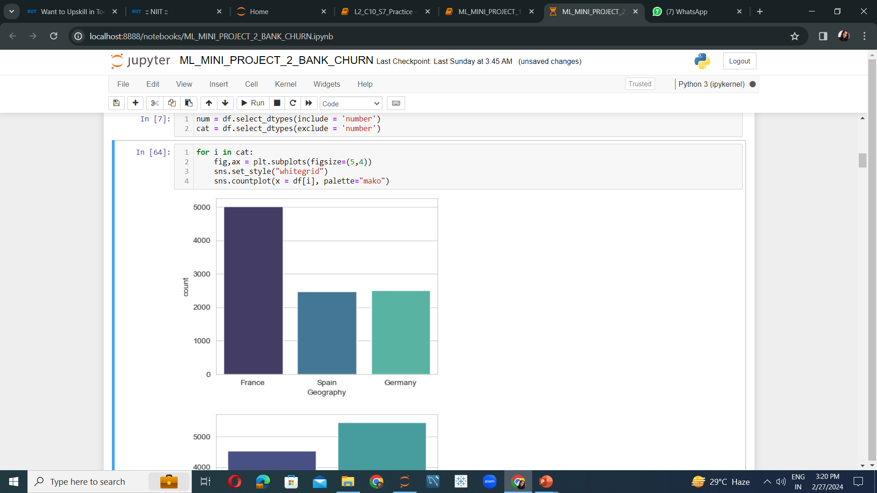
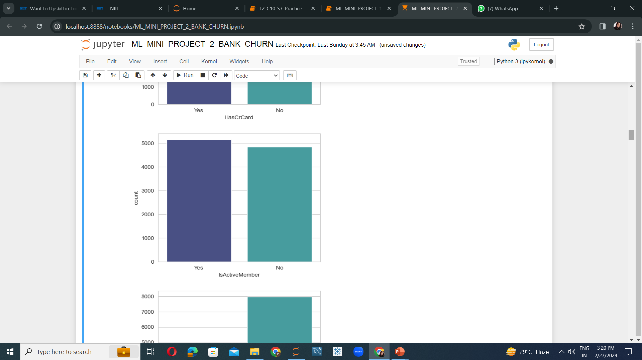
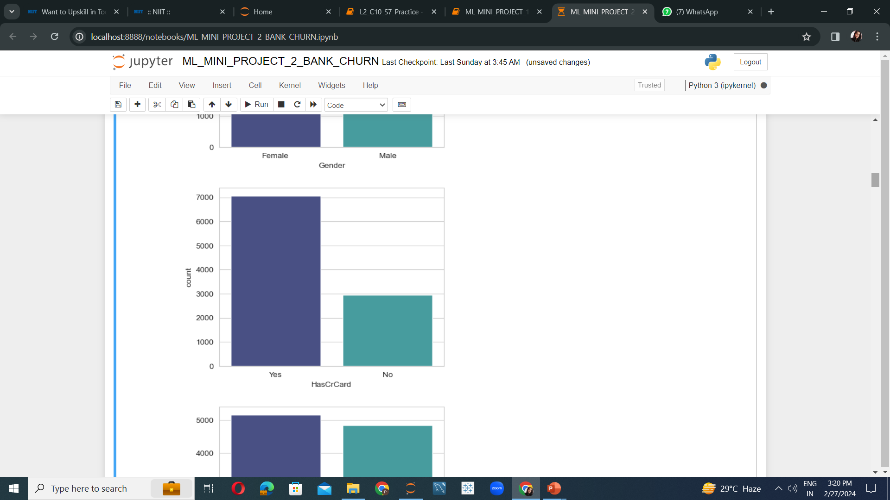
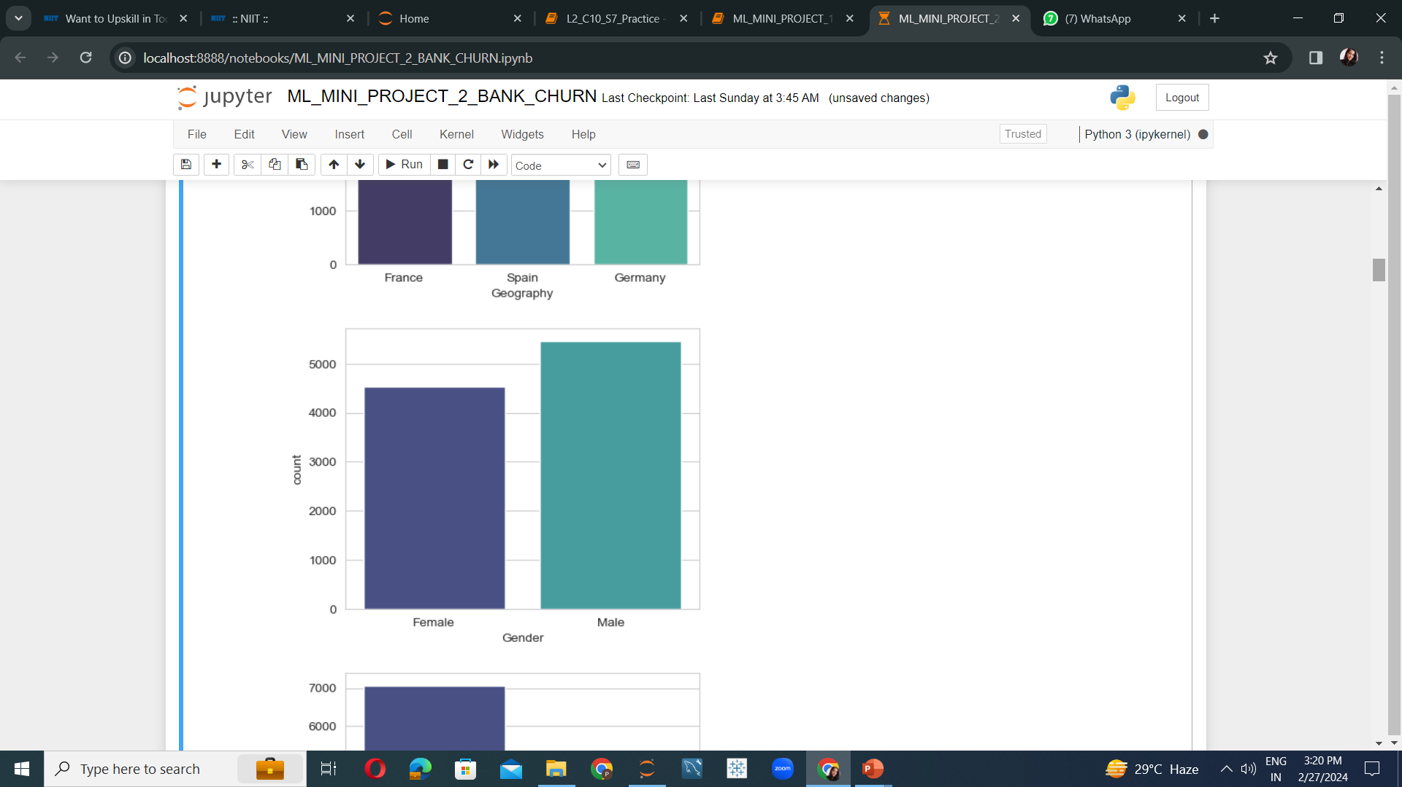
Analyzing Each Aspect
3
Most of the customers are from France
Number of active and inactive customers are almost equal.
More than 50% of the customers own a credit card.
Number of Male customers are slightly greater than the females.

Slide 4
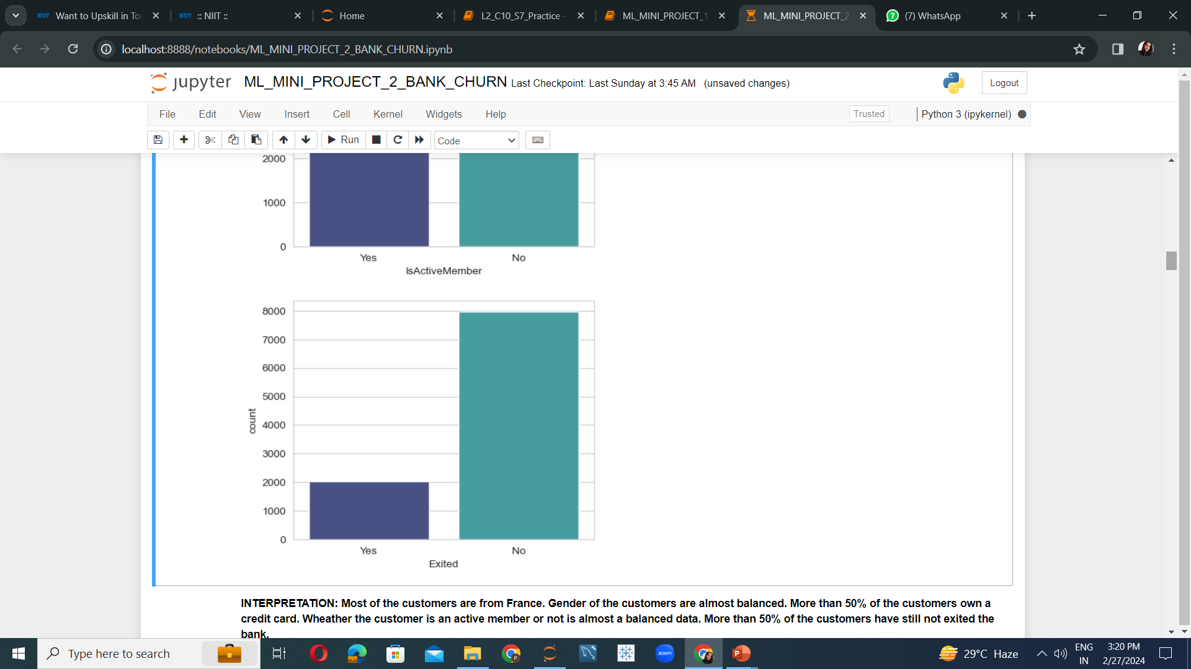
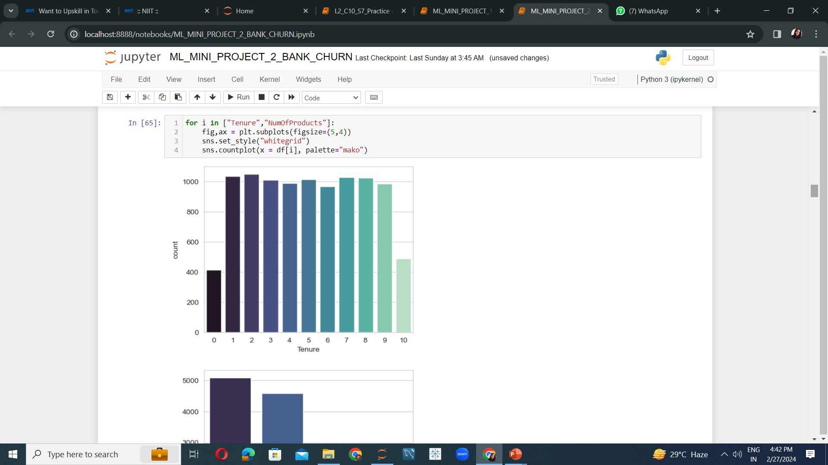
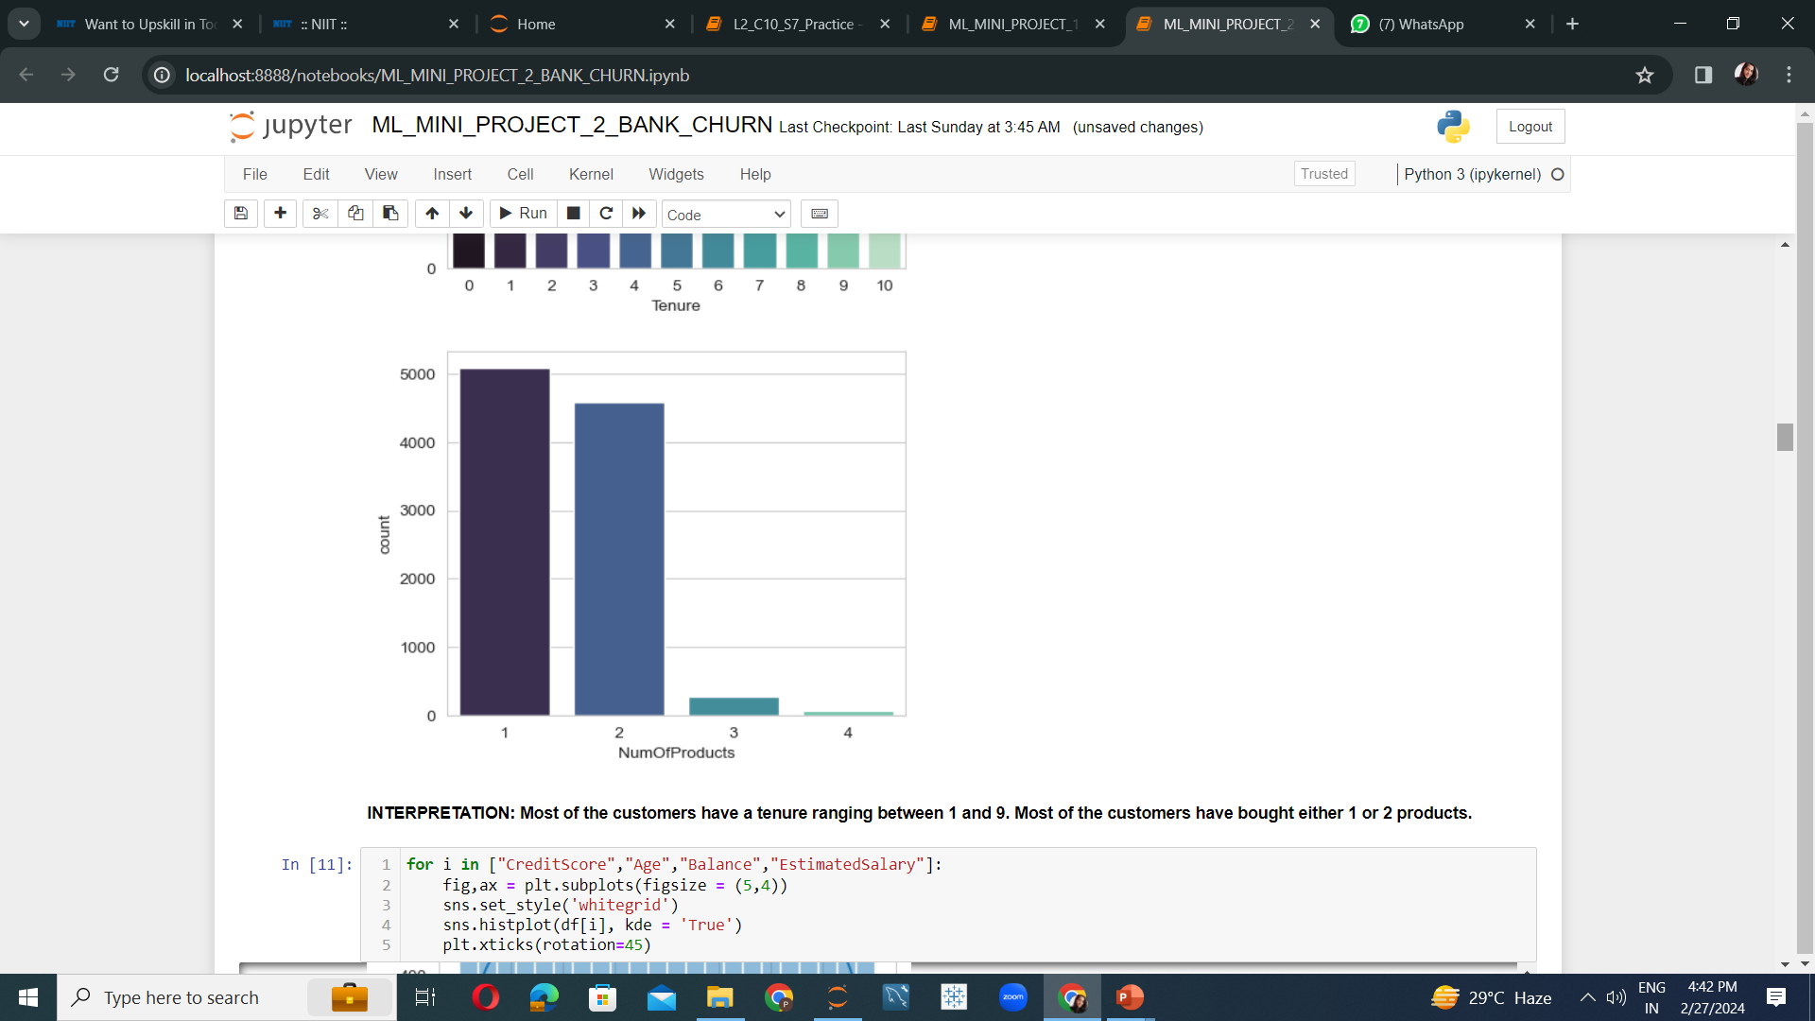
Analyzing with respect to the exiting status, tenure period and No of products purchased from the bank.
4
Ratio of existing vs exited customers. About 25% of customers have exited the bank.
Customers have mostly bought 1 or 2 products from the bank. Very few customers have bought 3 or 4 products.
Most of the customers have a tenure period ranging between 1 to 9.

Slide 5
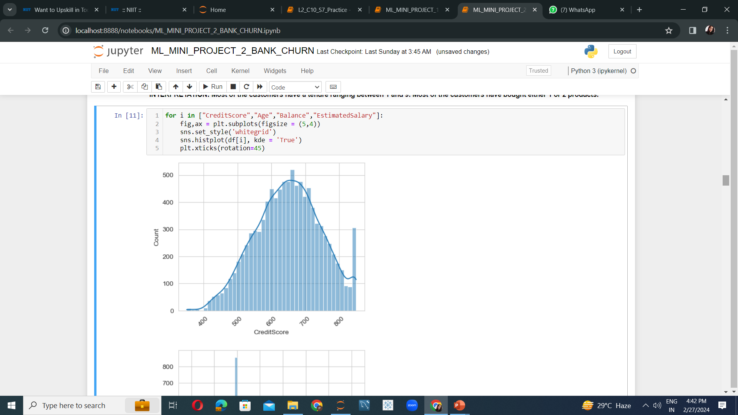
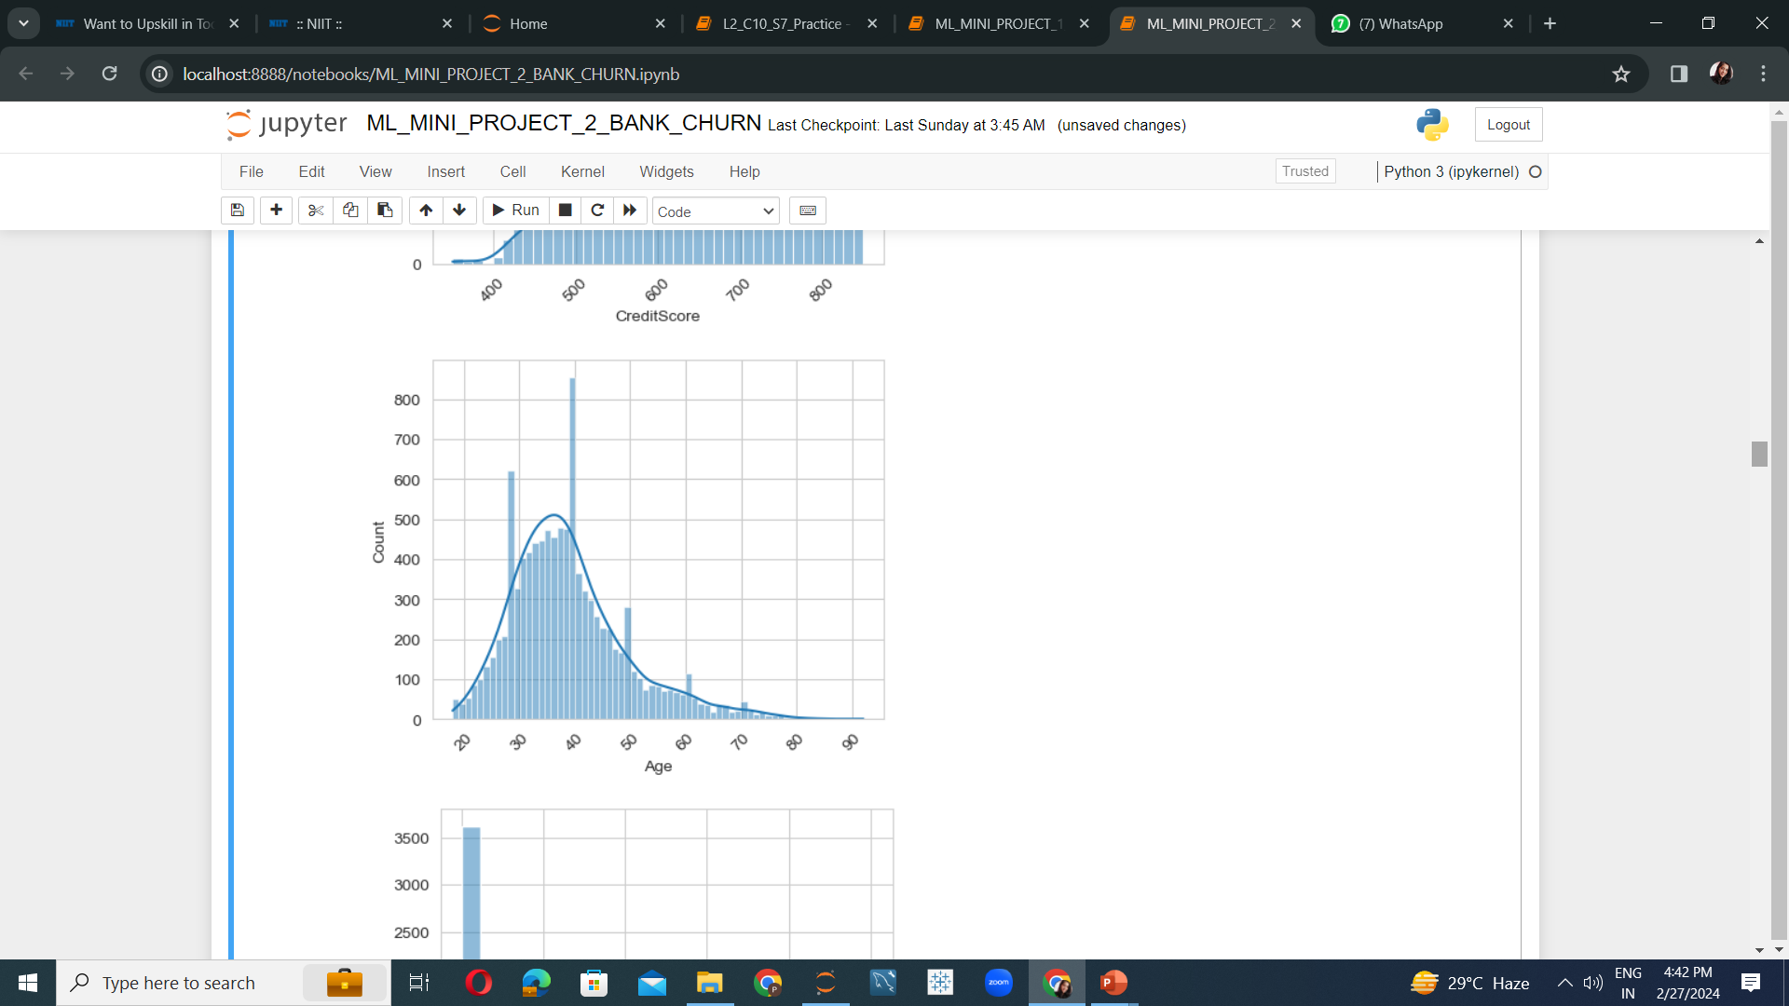
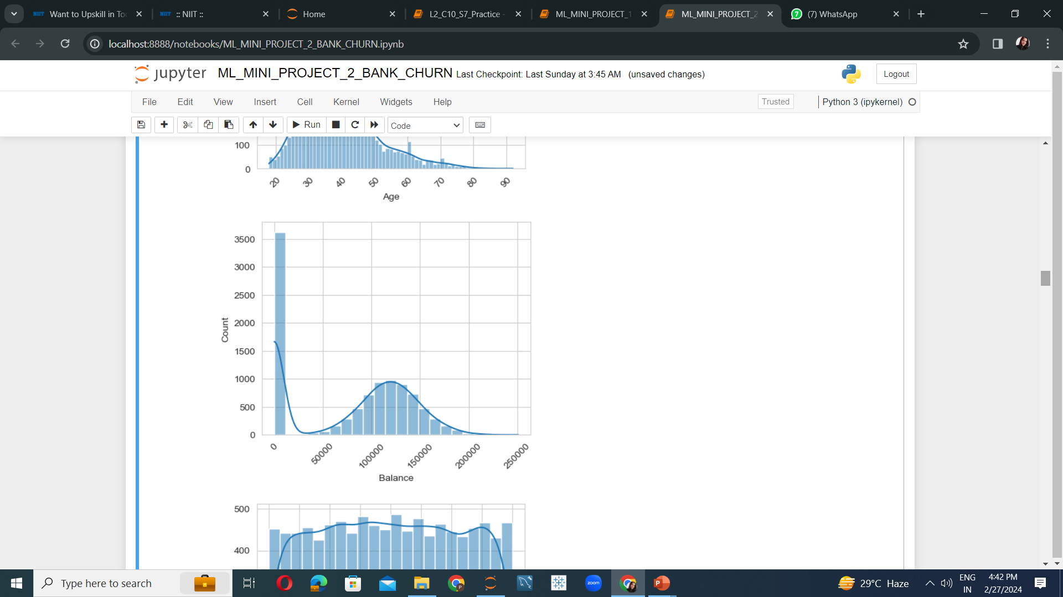
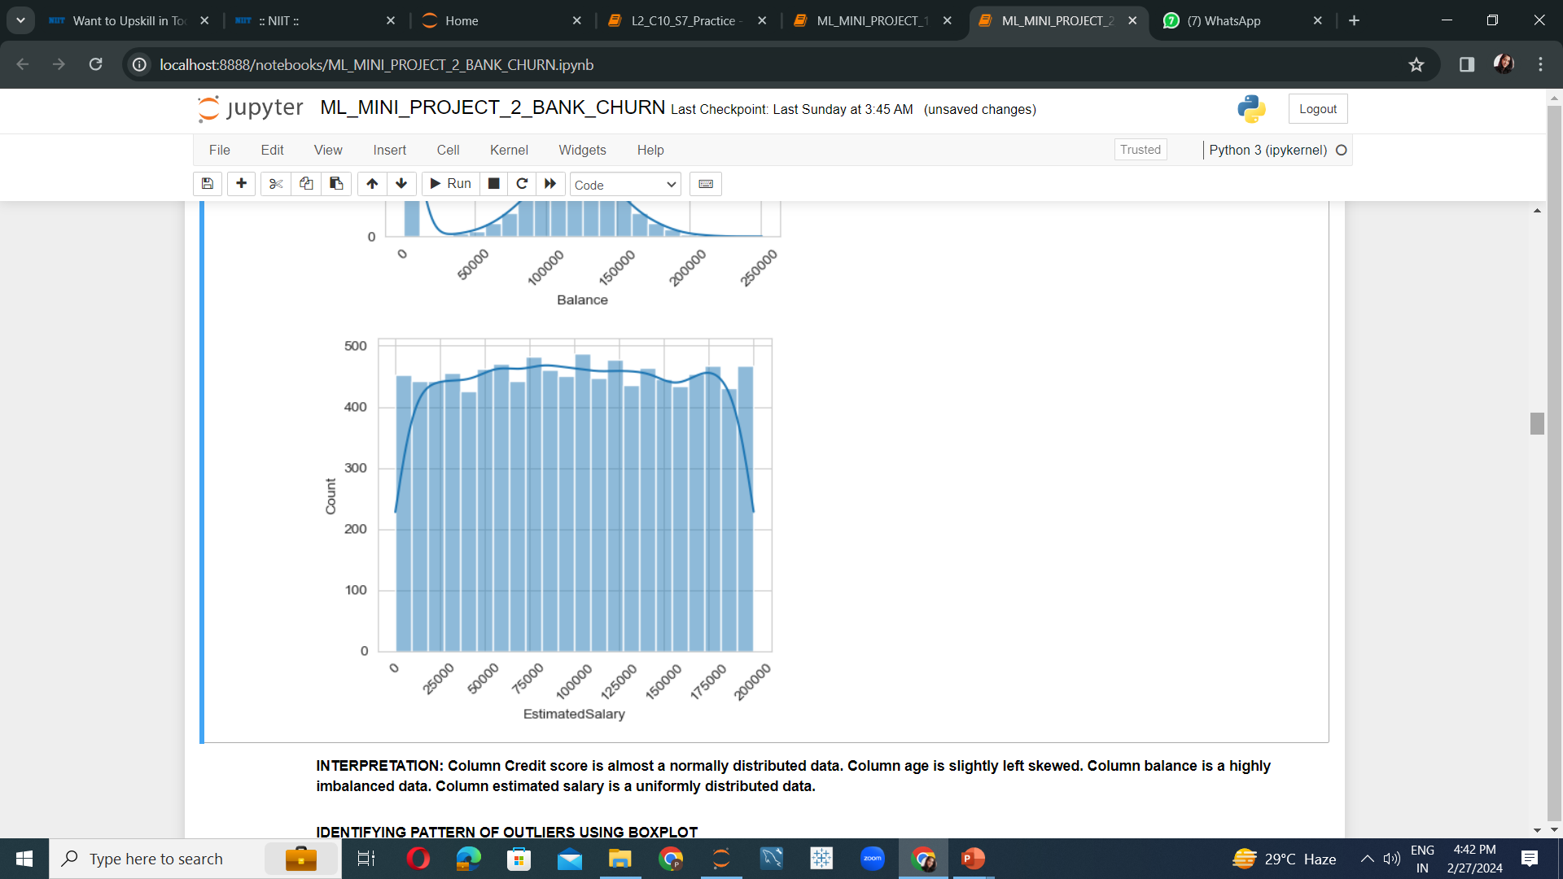
5
Credit scores of customers are almost normally distributed. Most customers have a credit score ranging between 600 to 700.
Customers are mostly of the age group 30 to 40.
Account balance of most customers is 0.
The salary of the customers are uniformly distributed.

Slide 6
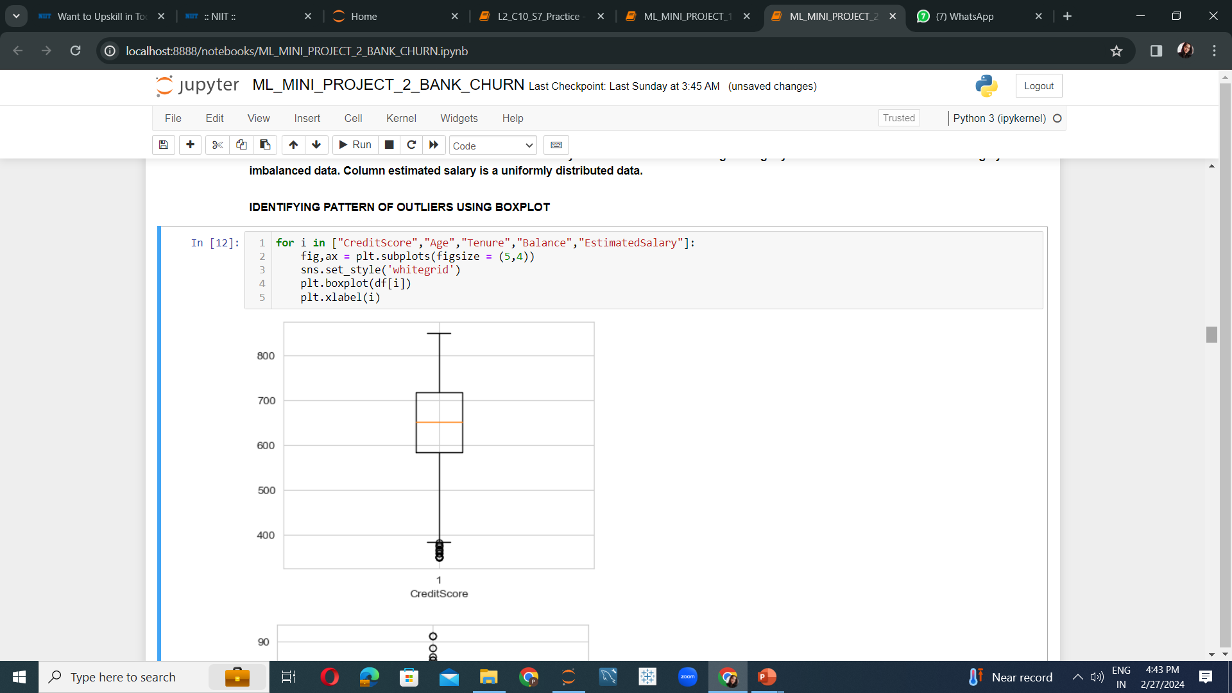
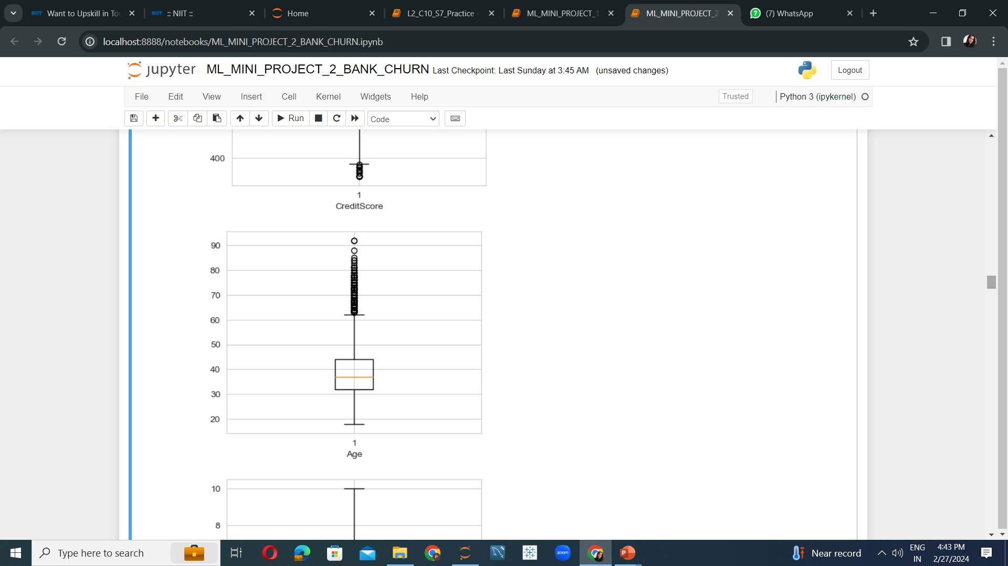

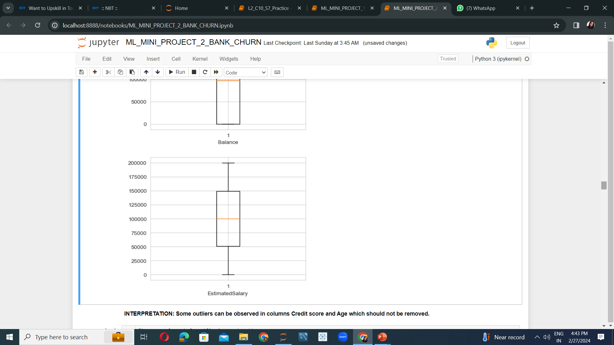
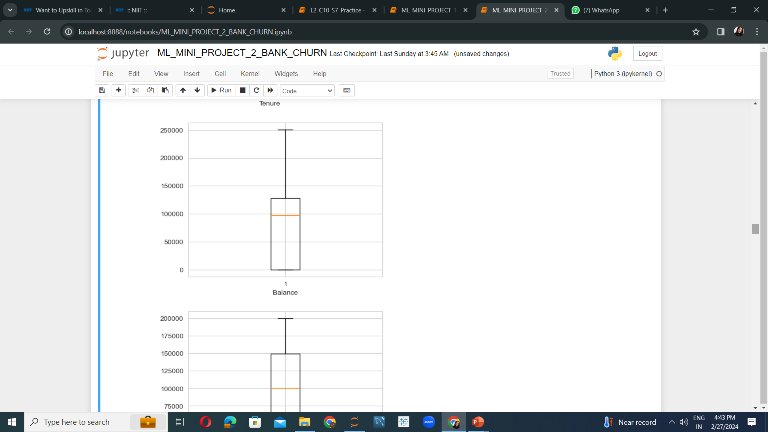
Some unusual patterns are observed in the credit score and the age of the customers.
No unusual patterns observed in the tenure period, salary or account balance of the customers.
6

Slide 7
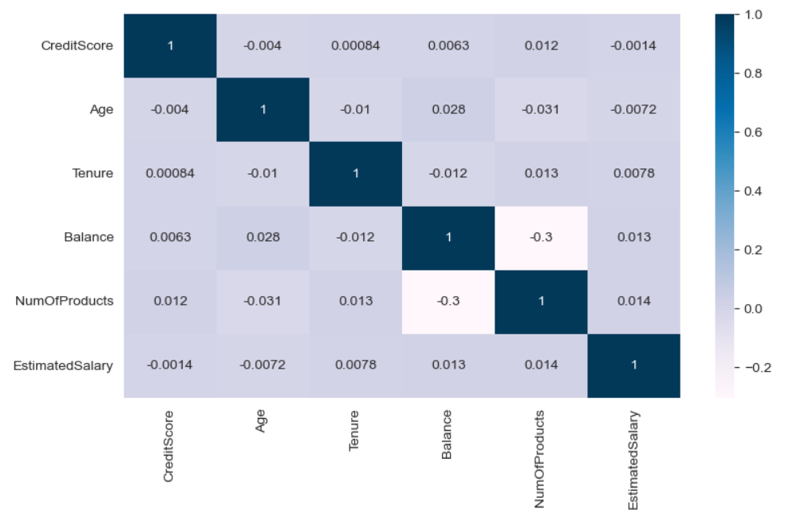
Analyzing if the factors are affecting each other by any means
None of the factors seem to be affecting each other.
7

Slide 8
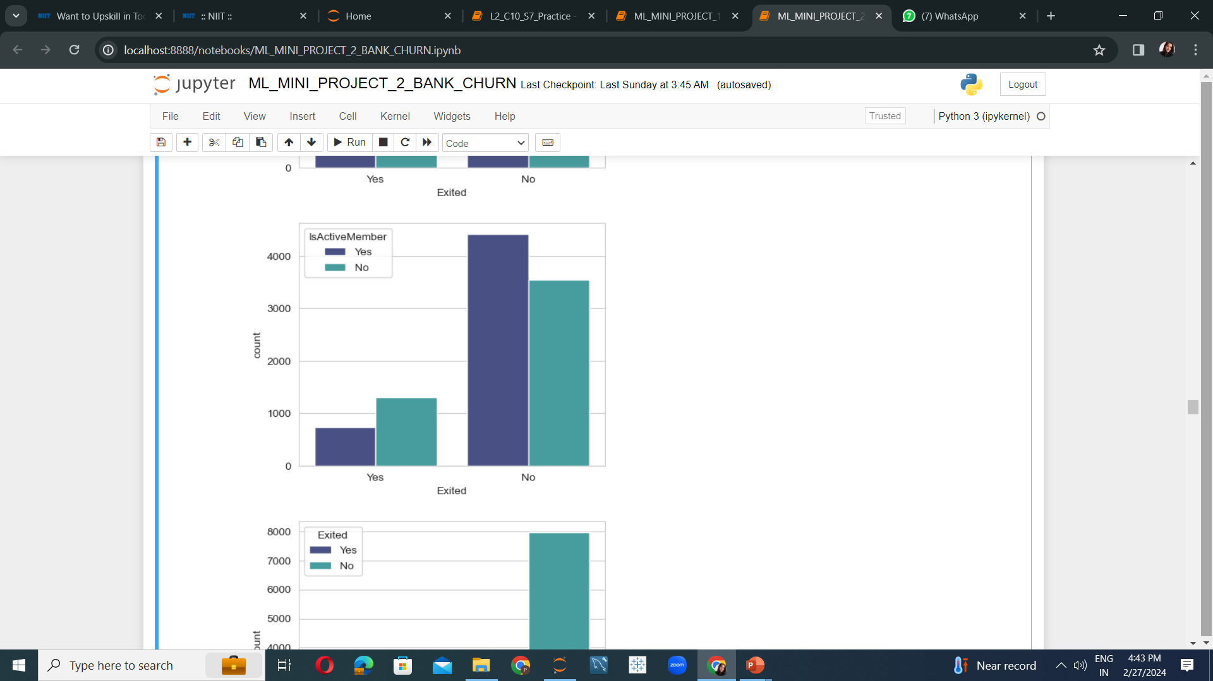
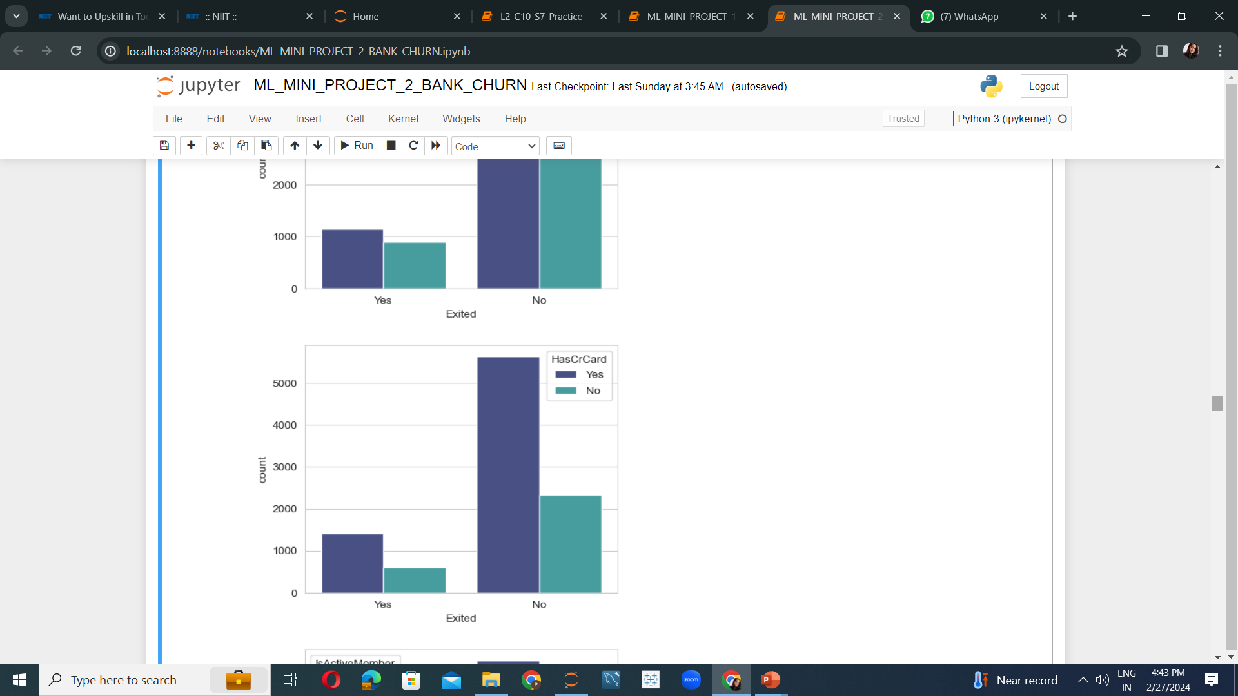
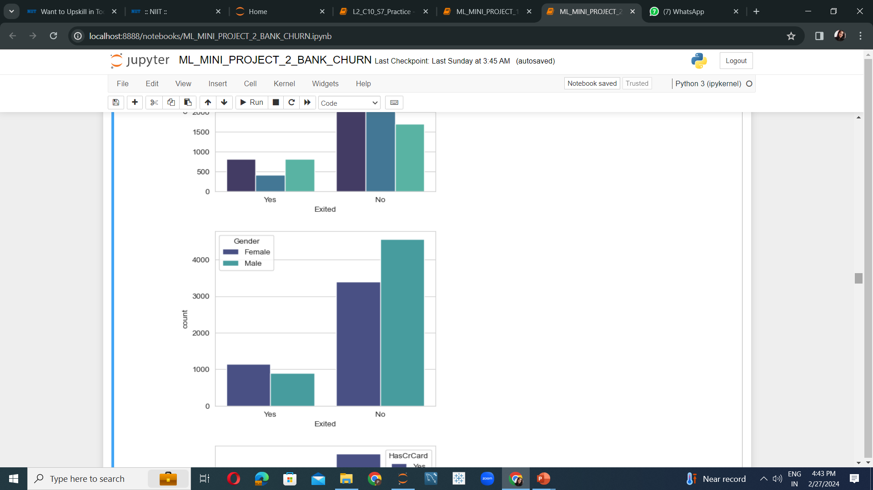
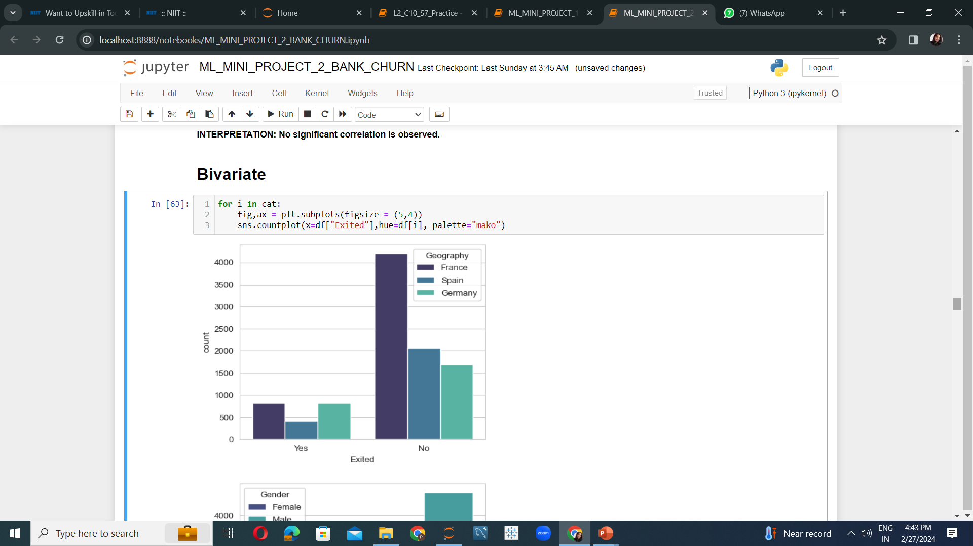
8
For both exited and existing customers, more than 50% own a credit card.
Majority of exited customers were inactive whereas majority of existing customers are active.
Exited customers were mainly from France and Germany whereas existing customers are majorly from France.
Most of the exited customers were females whereas most of the existing customers are males.

Slide 9
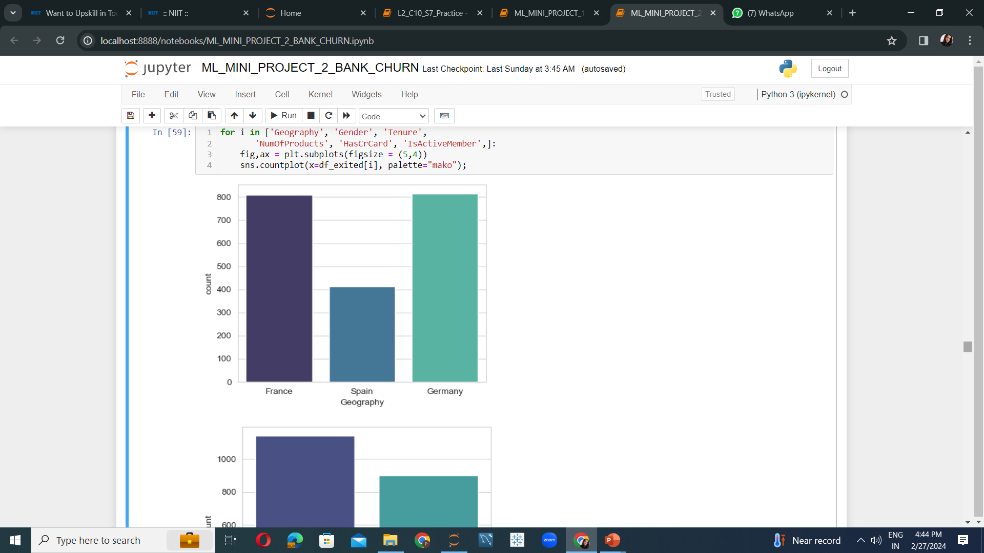
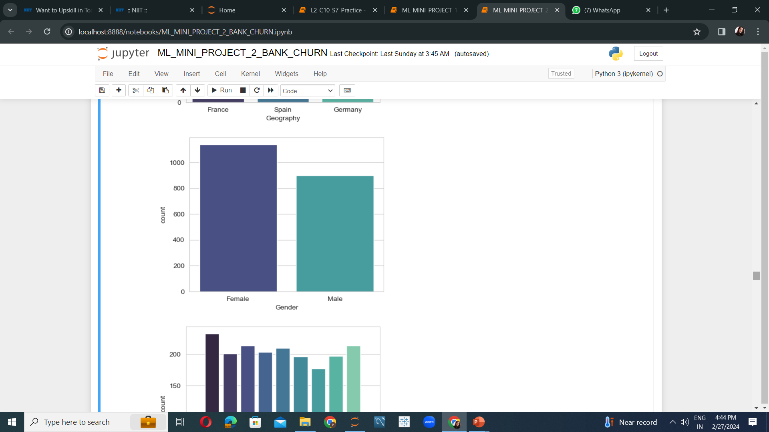
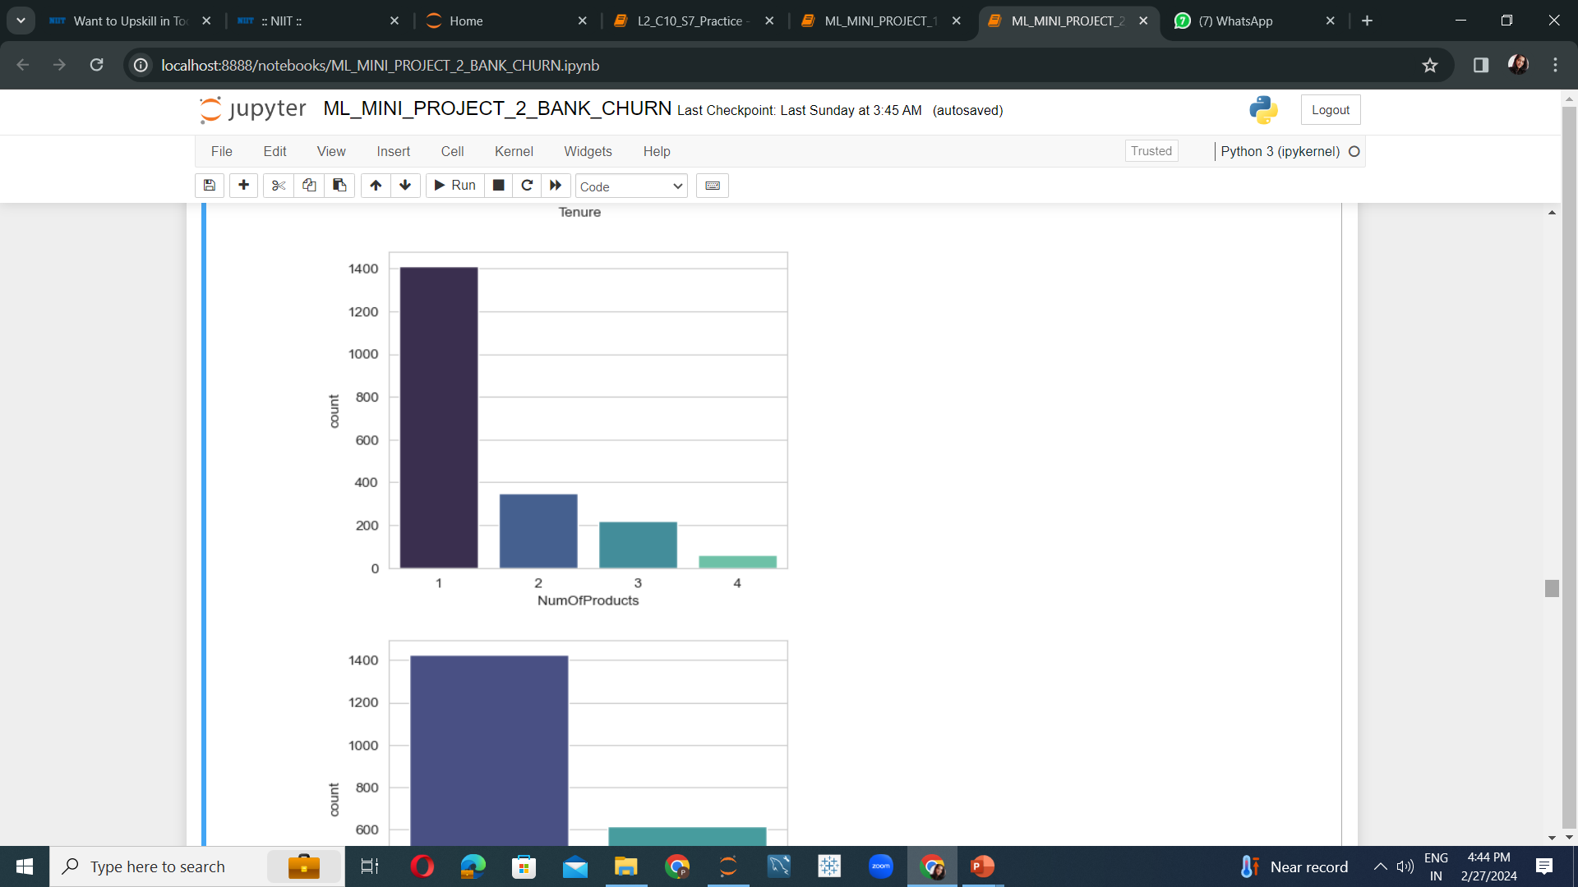
Analyzing patterns of the exited customers to gain insights for correct future prediction.
9
Insights about exited customers:
Majorly customers exited from France and Germany.
Most of them were females.
They mainly bought only one product from the bank.

Slide 10
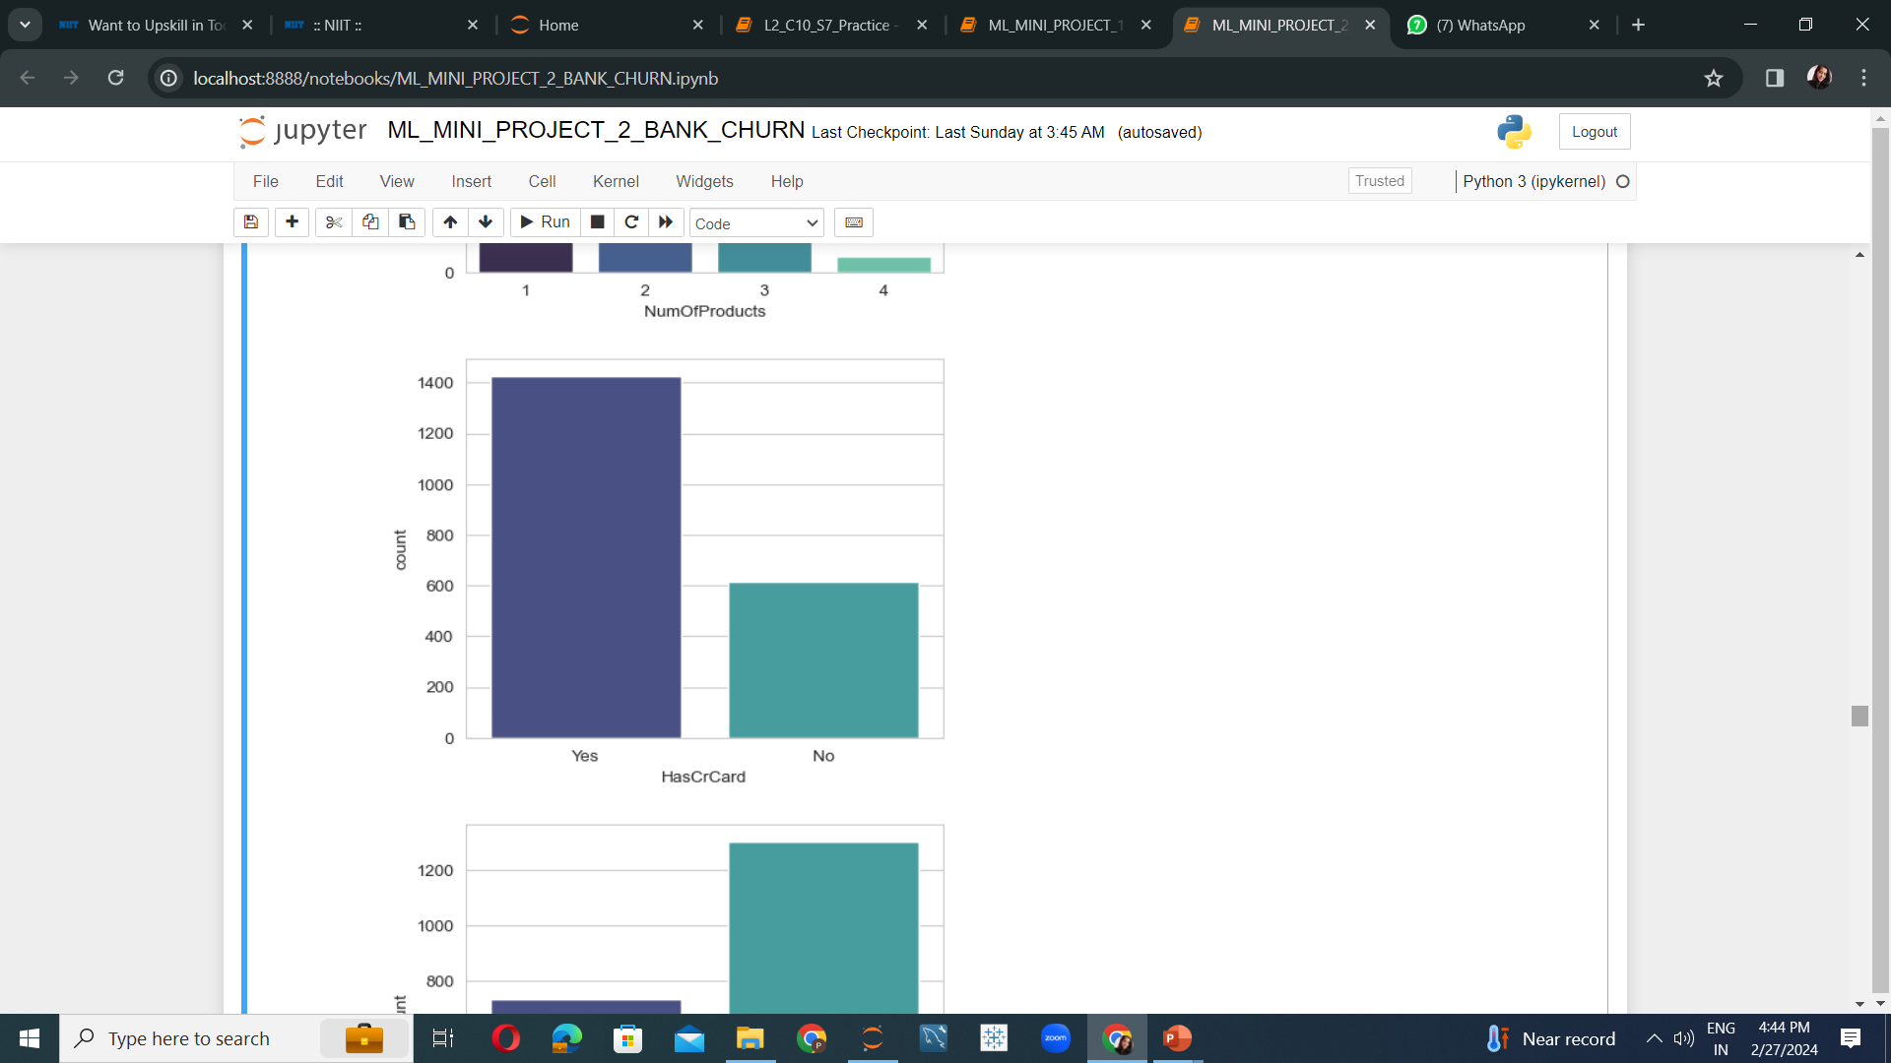
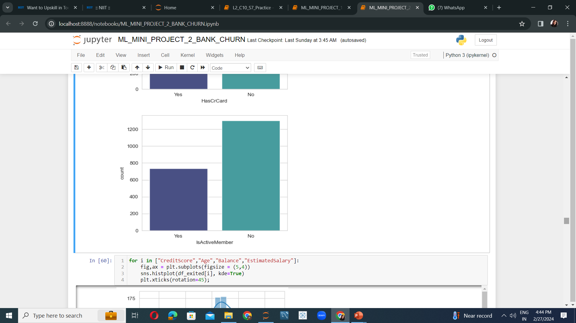
Analyzing with respect to credit card owning and active status of the exited customers.
10
Majority of the exited customers were credit card owners.
Majority of the exited customers were inactive members of the bank.

Slide 11
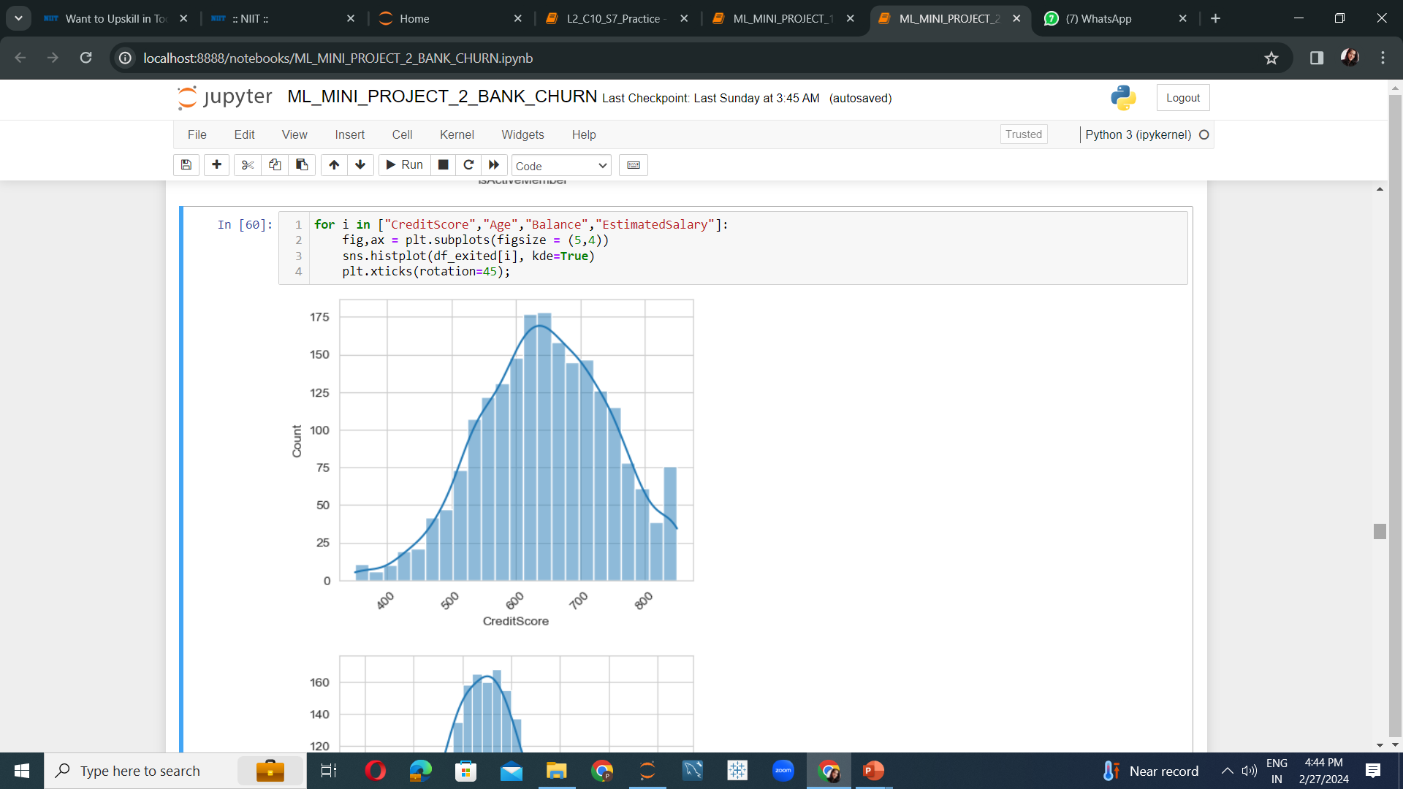
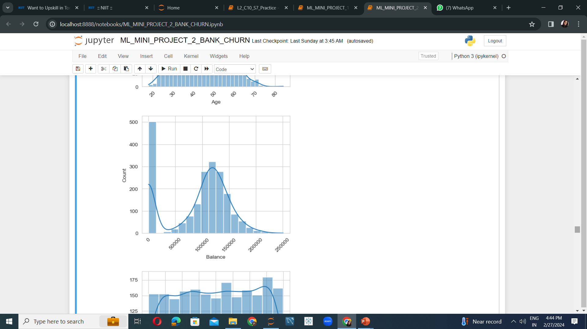
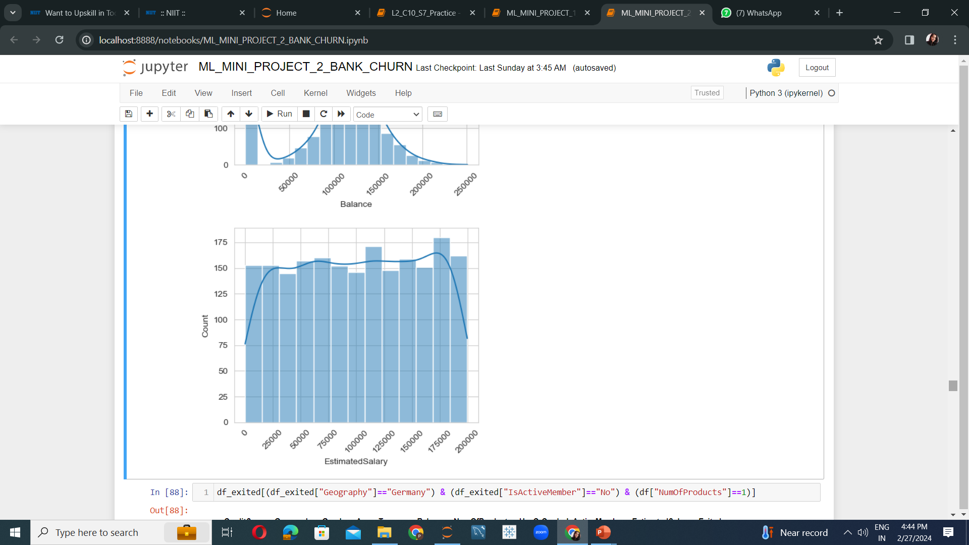
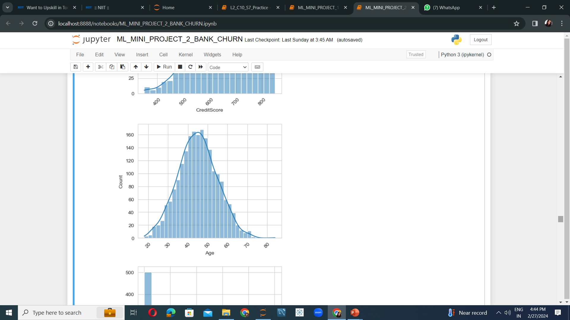
Analyzing the credit score, account balance, salary and age of the exited customers
11
No significant pattern observed in the behavior of the exited customers. It is the same as existing customers of the bank.

Slide 12
Algorithms and Comparisons
12
Algorithm | Evaluation Scores | Interpretation
Naive Bayes | Model Training Performance: 82.56% Model Testing Performance: 37.17% | R^2 value gives good performance f1 value gives poor performance. Conclusion: Overfitted model.
Bagging (Random Forest) | Model Training Performance: 84.54% Model Testing Performance: 85.37% | Both R^2 and f1 values are good. Conclusion: Good fit model.
Stacking (Logistic Regressor, Decision Tree Classifier, Support Vector Classifier, Naive Bayes) | Model Training Performance: 83.81% | Time consuming but no further model performance improvement as compared to Random Forest.
Hyperparameter tuning done using Grid Search method.
Parameter options: max_depth [20,25,30] and n_estimators [50,100,200].
Best selected parameter by model: max_depth [25]

Slide 13
Conclusion:
13
Customers belonging either from France or Germany and have bought only 1 product and are also not active members are mainly exiting the bank.
Business Understanding:
Existing customers belonging to Germany or France who have bought only 1 product and are not an active member of the bank anymore are likely to leave soon.
Business improvement strategy:
Provide personalized customer experience.
Implement a customer feedback loop.
Offer unique privileges and services to the customers.

Slide 14
THANK YOU

